Slide 1



UNIT 1
LESSON 2
MONEY MATTERS, PART 1

Slide 2
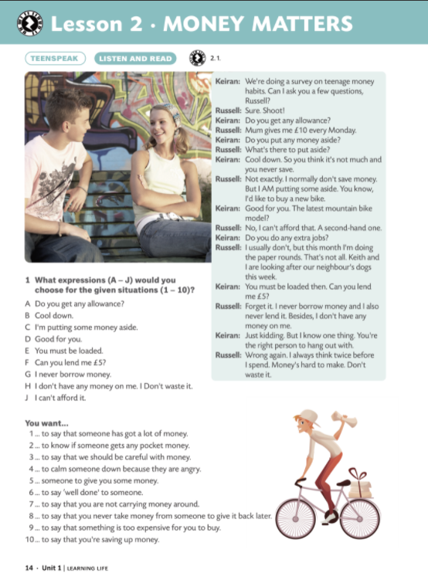

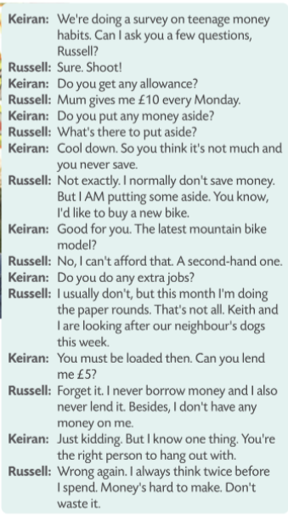


Slide 3
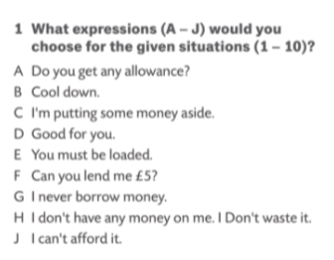

E
A
H
B
F
D
H
G
J
C

Slide 4


Slide 5
